Slide 1

SUBJECT: MACHINE LEARNING
FACULTY : Dr. V.SOWMYA
DEPARTMENT: DATA SCIENCE (CEN)

Slide 2
PRESENTATION BY
TEAM MEMBER | ROLL NUMBER
E VIGNESH | CB.EN.P2DSC21010
RAHUL NAMDEV CHAVAN | CB.EN.P2DSC21021
N SAI DHANUSH | CB.EN.P2DSC21016

Slide 3
K-NEAREST NEIGHBORS
SUPERVISED CLASSIFICATION ALGORITHM

Slide 4
BRIEF INTRODUCTION TO KNN
K Nearest Neighbor algorithm falls under the Supervised Learning category and is used for classification (most commonly) and regression.
K-NN is a simple algorithm that stores all the available cases and classifies the new data based on a similarity measure
K-NN is Considered as a Lazy Learning Algorithm( Instance based learning),that classify datasets based on their similarity with neighbors.
“K” in KNN is a parameter that refers to the number of nearest neighbours to include in the majority of the voting process.

Slide 5
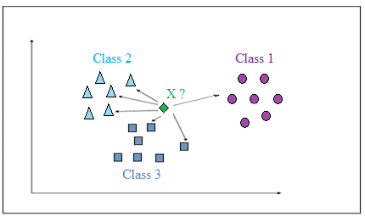
KNN: CLASSIFICATION APPROACH
Choose a “K” Value.
Sort Feature vectors (N-dimensional space) by a Distance Metric.
Choose Class based on Voting for K nearest Instances .

Slide 6
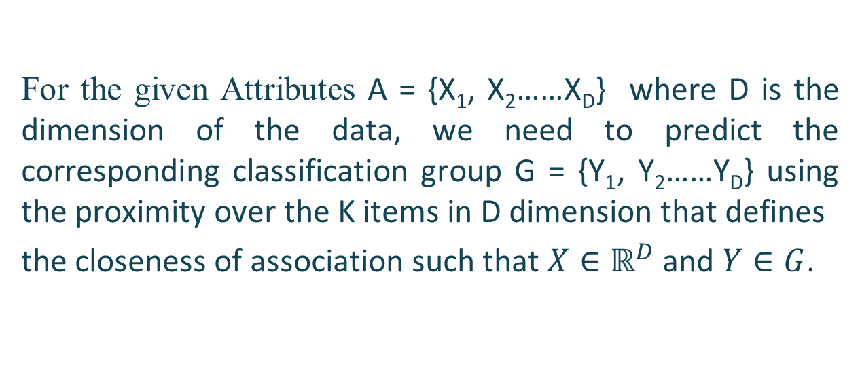
TECHNICALLY….
For the given Attributes A = {X₁, X₂……X_{D}} where D is the dimension of the data, we need to predict the corresponding classification group G = {Y₁, Y₂……Y_{D}} using the proximity over the K items in D dimension that defines
the closeness of association such that $X∈ℝ^{D}$ and $Y∈G$.

Slide 7
START
KNN FLOWCHART
Specify the value of “K”(K = Number of nearest neighbors)
Scale the data using standardization
Calculate the distance between the Test instance and all the Training instances using a Distance measure
Sort the Distances
Determine the nearest neighbors based on the Kth minimum distance
Gather the Target or Label of the nearest neighbors
Use the majority of the category of nearest neighbors as the prediction value of the test instance to classify it
END

Slide 8
FEATURE SCALING
Our Dataset contains Features which are highly varying in Magnitude, units and range.
Distance between neighbors could be dominated by some attributes with relatively large numbers.
we scale our data before employing a distance based Algorithm, so that all features contribute equally to the result.
TYPES OF FEATURE SCALING TECHNIQUES:
NORMALIZATION
STANDARDIZATION

Slide 9
FEATURE SCALING TECHNIQUE: NORMALIZATION
Normalization is a scaling technique in which values are shifted and rescaled,
so that they end up ranging between 0 and 1.
It is also known as Min-Max Scaling and formula is given as
Here,
Xmax & Xmin are the maximum & minimum values in the features respectively.
X is value before Normalization & X' is value after Normalization.

Slide 10
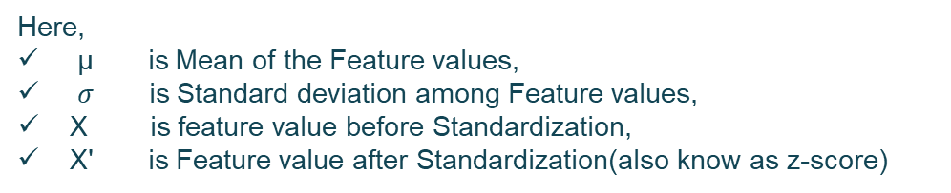
FEATURE SCALING TECHNIQUE: STANDARDIZATION
Standardization is another scaling technique, where the values are centered with zero Mean
and unit standard deviation.
This means that the Mean of the attributes becomes zero and the resultant distribution has a
standard normal distribution.
And the formula is given as:
Here,
µ is Mean of the Feature values,
$σ$ is Standard deviation among Feature values,
X is feature value before Standardization,
X' is Feature value after Standardization(also know as z-score)

Slide 11
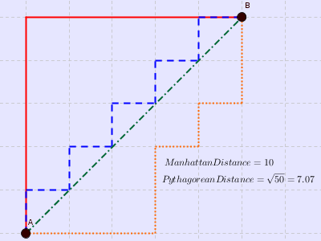
KNN: DISTANCE METRICS
MANHATTAN DISTANCE
where,
n = number of dimensions
or features.
P & Q are instances or
data points.

Slide 12
KNN: DISTANCE METRICS
MINKOWSKI DISTANCE is a Generalization of Euclidean,
Chebychev and Manhattan distance and is given as:
where, “q” is a parameter,
“n” is number of dimensions(attributes),
X and Y are data points or Instances.
If q = 1; then “D” becomes Manhattan distance.
If q = 2; then “D” becomes Euclidean distance.
If q = infinity; then “D” becomes Chebychev distance.

Slide 13
STRENGTHS OF KNN:
Very Simple and Intutive.
Can be applied to data from any Distrubution.
Good Classification, if the number of samples are large Enough.
LIMITATIONS OF KNN:
Takes more time to Classify a new example.
Need to Calculate & compare distance from a new example to all other examples.
Choosing “K” value may be tricky.
Needs large number of Samples for Accuracy.

Slide 14
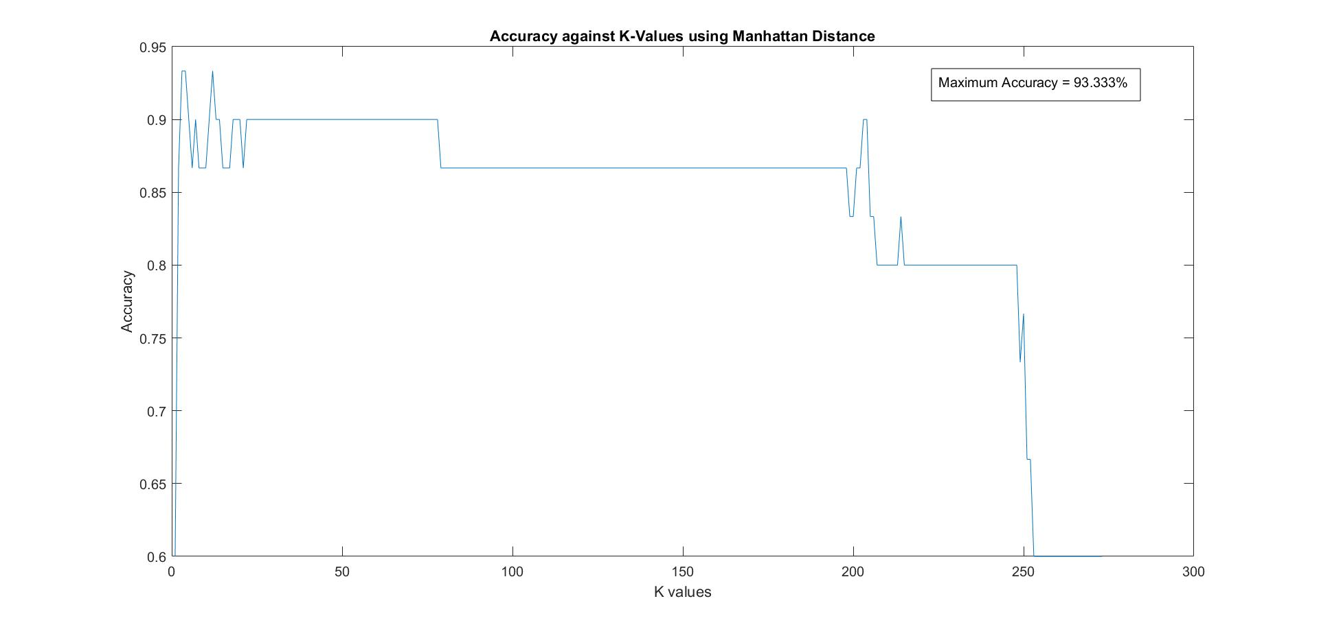
Accuracy vs k-values Plot for Manhattan distance

Slide 15
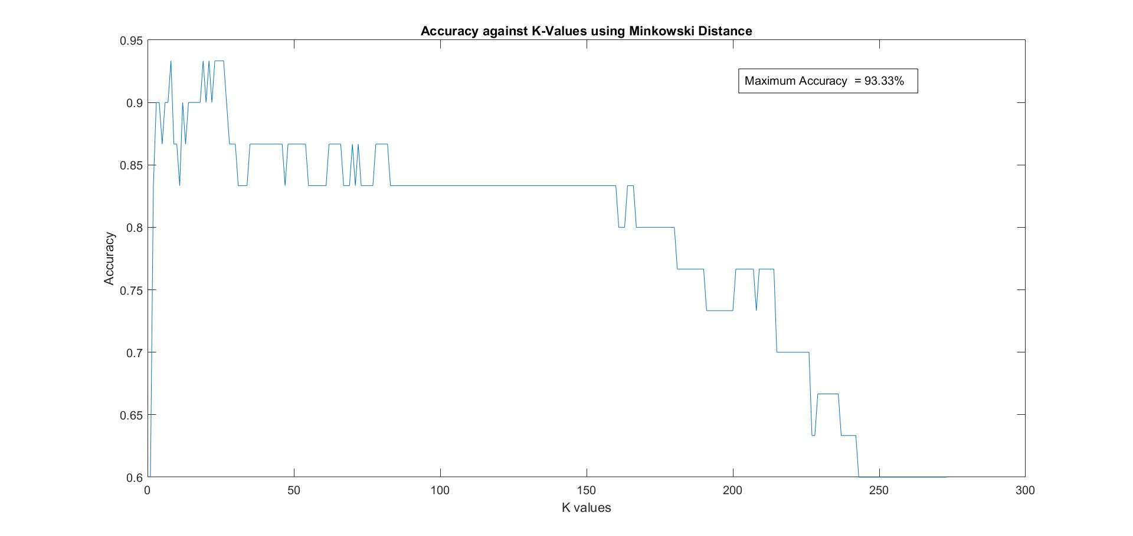
Accuracy vs k-values Plot for Minkowski distance

Slide 16
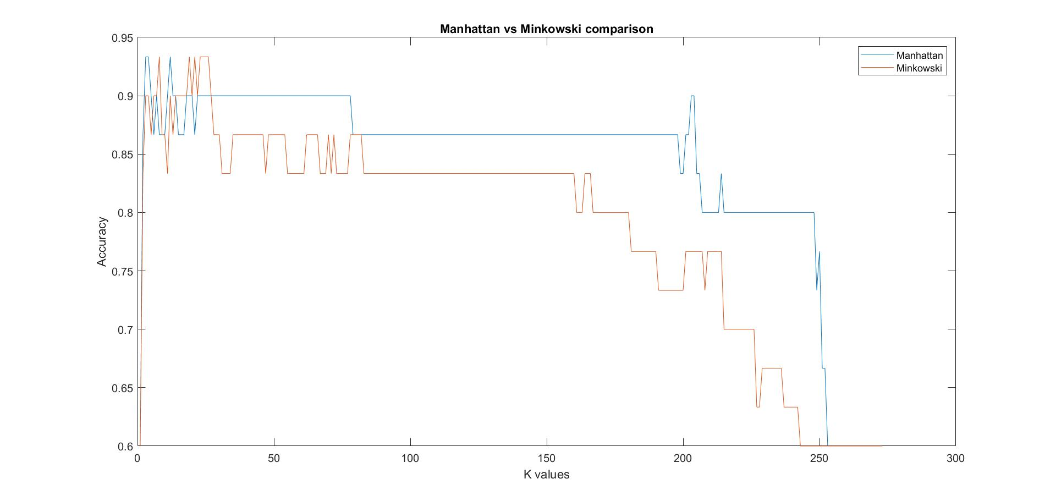
Manhattan vs Minkowski

Slide 17
CONCLUSION:
DISTANCE METRIC | Maximum Accuracy Obtained ( in %) | Values of “K” , for which highest Accuracy achieved
MANHATTAN | 93.33 | K = 4, 12
MINKOWSKI | 93.33 | K = 8,19,21,23,24,25,26

Slide 18
THANK YOU

